Slide 1
Fuzzy Merging with Company Names
Richard Vogg
Sep 26th, 2019

Slide 2


Slide 3


Slide 4
Evalueserve

Slide 5

Evalueserve
Evaluserv

Slide 6
Evalueserve
Evalueserve
Evaluserv
EVALUESERVE
Evalueserve
Evalueserve
Evalueserve
Evalueserve S.A.

Slide 7



Evalueserve
Evalueserve
Evalueserve
Evaluserv
EVALUESERVE
Evaluesurf
Evalueserve
Evalueserve
Evalueserve
evalueserve
Evaluserv
EVLAUESERV
Evalueserve
Evalueserve
Evalueserve
EVALUSERVE
Evelueserv
Evalueserve SA
Evalueserve
Evalueserve
Evalueserve
Evalueserve
E-Value Serve
Evalueserve

Slide 8




Evalueserv
Evalueserv
Evalueserv
Evalueserv
Evalueserv
Evalueserv
Evalueserv
Evalueserv
Evalueserv
Evalueserv
Evalueserv
Evalueserv
Evalueserv
Evalueserv
Evalueserv
Evalueserv
Evalueserv
Evalueserv
Evalueserv
Evalueserv
Evalueserv
Evalueserv
Evalueserv
Evalueserv
Evalueserv
Evalueserv
Evalueserv
Evalueserv
Evalueserv
Evalueserv
Evalueserv
Evalueserv
Evalueserv
Evalueserv
Evalueserv
Evalueserv
Evalueserv
Evalueserv
Evalueserv
Evalueserv
Evalueserv
Evalueserv
Evalueserv
Evalueserv
Evalueserv
Evalueserv
Evalueserv
Evalueserv
Evalueserv
Evalueserv
Evalueserv
Evalueserv
Evalueserv
Evalueserv
Evalueserv
Evalueserv
Evalueserv
Evalueserv
Evalueserv
Evalueserv
Evalueserv
Evalueserv
Evalueserv
Evalueserv
Evalueserv
Evalueserv
Evalueserv
Evalueserv
Evalueserv
Evalueserv
Evalueserv
Evalueserv
Evalueserv
Evalueserv
Evalueserv
Evalueserv
Evalueserv
Evalueserv
Evalueserv
Evalueserv
Evalueserv
Evalueserv
Evalueserv
Evalueserv
Evalueserv
Evalueserv
Evalueserv
Evalueserv
Evalueserv
Evalueserv
Evalueserv
Evalueserv
Evalueserv
Evalueserv
Evalueserv
Evalueserv
Evalueserv
Evalueserv
Evalueserv
Evalueserv
Evalueserv
Evalueserv
Evalueserv
Evalueserv
Evalueserv
Evalueserv
Evalueserv
Evalueserv
Evalueserv
Evalueserv
Evalueserv
Evalueserv
Evalueserv
Evalueserv
Evalueserv
Evalueserv
Evalueserv
Evalueserv
Evalueserv
Evalueserv
Evalueserv
Evalueserv
Evalueserv
Evalueserv
Evalueserv
Evalueserv
Evalueserv
Evalueserv
Evalueserv
Evalueserv
Evalueserv
Evalueserv
Evalueserv
Evalueserv
Evalueserv
Evalueserv
Evalueserv
Evalueserv
Evalueserv
Evalueserv

Slide 9
The input

Slide 10
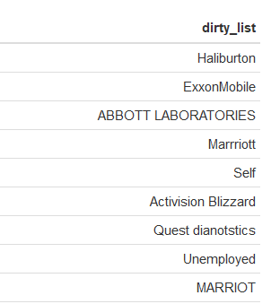
The input
500,000 names

Slide 11
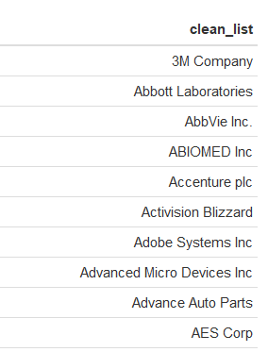
The input
500,000 names
S&P500 list

Slide 12
The stringdist package
Approximate matching and string distance calculations for R.
Many distance functions: Hamming, Levenshtein, Longest common substring, qgram, Jaro-Winkler
Computes in parallel when possible
van der Loo M (2014). “The stringdist package for approximate string matching.” The R Journal, 6, 111-122. https://CRAN.R-project.org/package=stringdist.

Slide 13
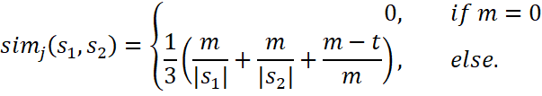
Jaro similarity
1 | 2 | 3 | 4 | 5 | 6 | 7 | 8 | 9
B | R | E | A | K | F | A | S | T
B | A | S | E | B | A | L | L
1 | 2 | 3 | 4 | 5 | 6 | 7 | 8

Slide 14
Jaro similarity
1 | 2 | 3 | 4 | 5 | 6 | 7 | 8 | 9
B | R | E | A | K | F | A | S | T
B | A | S | E | B | A | L | L
1 | 2 | 3 | 4 | 5 | 6 | 7 | 8

Slide 15
Jaro similarity
1 | 2 | 3 | 4 | 5 | 6 | 7 | 8 | 9
B | R | E | A | K | F | A | S | T
B | A | S | E | B | A | L | L
1 | 2 | 3 | 4 | 5 | 6 | 7 | 8

Slide 16
Jaro similarity
1 | 2 | 3 | 4 | 5 | 6 | 7 | 8 | 9
B | R | E | A | K | F | A | S | T
B | A | S | E | B | A | L | L
1 | 2 | 3 | 4 | 5 | 6 | 7 | 8

Slide 17
Jaro similarity
1 | 2 | 3 | 4 | 5 | 6 | 7 | 8 | 9
B | R | E | A | K | F | A | S | T
B | A | S | E | B | A | L | L
1 | 2 | 3 | 4 | 5 | 6 | 7 | 8

Slide 18
Jaro similarity
1 | 2 | 3 | 4 | 5 | 6 | 7 | 8 | 9
B | R | E | A | K | F | A | S | T
B | A | S | E | B | A | L | L
1 | 2 | 3 | 4 | 5 | 6 | 7 | 8

Slide 19
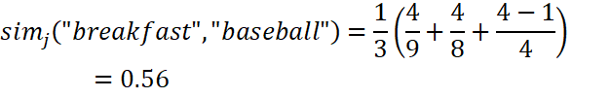
Jaro similarity
1 | 2 | 3 | 4 | 5 | 6 | 7 | 8 | 9
B | R | E | A | K | F | A | S | T
B | A | S | E | B | A | L | L
1 | 2 | 3 | 4 | 5 | 6 | 7 | 8

Slide 20

Jaro-Winkler similarity
1 | 2 | 3 | 4 | 5 | 6 | 7 | 8 | 9
B | R | E | A | K | F | A | S | T
B | A | S | E | B | A | L | L
1 | 2 | 3 | 4 | 5 | 6 | 7 | 8

Slide 21
The process: cleaning
data
cleandata
cleaner <- function(data) {
wordremove <- c(" and "," comp "," company","companies"," corp "," inc ","[.]com")
data <- data %>% tolower() %>%
{gsub(paste(wordremove,collapse='|'),"",.)} %>%
{gsub("[[:punct:]]","",.)} %>%
{gsub("[[:blank:]]","",.)}
return(data)
}

Slide 22
The process: cleaning
Harley-Davidson
Cincinatti Financial
Quest Diagnostics
HARLEY DAVISON
Cincinatti financial corp
quest diags
cincinattifinancial harleydavison questdiags
cincinattifinancial harleydavidson questdiagnostics
clean_list_cl <- cleaner(clean_list)
dirty_list_cl <- cleaner(dirty_list)

Slide 23
The process: distance matrix
 | cincinattifinancial | harleydavison | otherexample | questdiags
harleydavidson | 0.67 | 0.01 | 0.54 | 0.51
cincinattifinancial | 0 | 0.66 | 0.64 | 0.68
questdiagnostics | 0.47 | 0.46 | 0.63 | 0.08
library(stringdist)
distmatrix <- stringdist::stringdistmatrix(clean_list_cl, dirty_list_cl,method='jw‘,p=0.1)

Slide 24
The process: minima detection
 | cincinattifinancial | harleydavison | otherexample | questdiags
harleydavidson | 0.67 | 0.01 | 0.54 | 0.51
cincinattifinancial | 0 | 0.66 | 0.64 | 0.68
questdiagnostics | 0.47 | 0.46 | 0.63 | 0.08
output <- data.frame(original=dirty_list)
best_fit <- apply(distmatrix,2,which.min) %>% as.integer()
output$best_fit <- clean_list[best_fit]
output$distance <- apply(distmatrix,2,min)

Slide 25
The process: thresholding
 | cincinattifinancial | harleydavison | otherexample | questdiags
harleydavidson | 0.67 | 0.01 | 0.54 | 0.51
cincinattifinancial | 0 | 0.66 | 0.64 | 0.68
questdiagnostics | 0.47 | 0.46 | 0.63 | 0.08
output$final <- ifelse(control$distance<0.12,control$best_fit,NA)

Slide 26
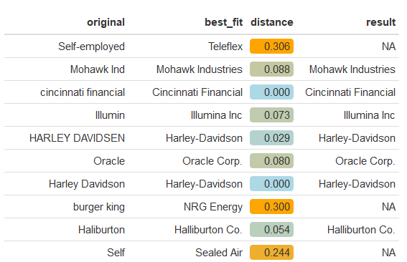
The output

Slide 27
The value of Fuzzy merging
Descriptive
S&P 500 customer analysis
Regional opportunities
Predictive
Add value to predictive models
Churn analysis
Combinations
Identify customers in managing positions in S&P 500 companies

Slide 28
Other pplications
Our approach: Dirty list vs clean list
Fuzzy search
Record linkage
De-duplication

Slide 29

Thank you!
richard.vogg@web.de
Richard Vogg
@richard_vogg

